Slide 1
Waterway Cleanups
Planning and Implementing

Slide 2
Short History: Annual Great Texas River Clean Up
Started in 1985 by the TRPA-38th Annual
Whole 75 Miles- Upper and Lower
San Marcos River

Slide 3
Planning
Donations
Monetary
In Kind
Google Map and Sign up
Interactive map for clean up Locations
Sign Up Genius for specific locations
Some Walkups
Meeting and Training
MS4 information training
Watershed breakout
Supplies
Bags, Grabbers, gloves
Shirts
Food
Tacos
Pizza

Slide 4
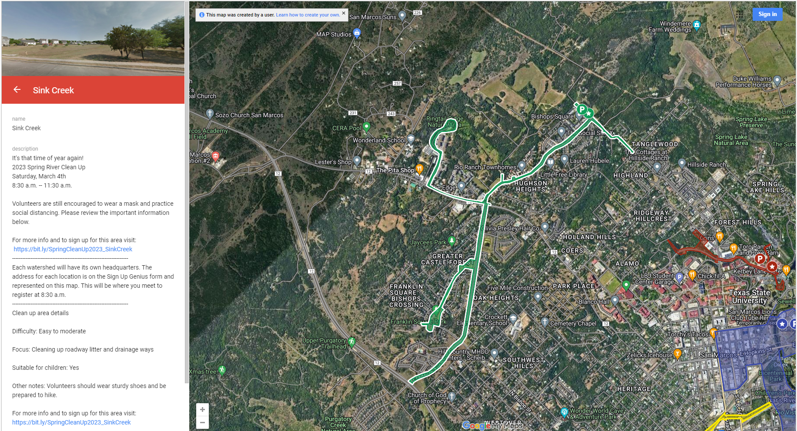
Mapping Clean up areas

Slide 5
Watershed Breakout
Watershed
Watershed Leader
Watershed assistant
Floater
Crew leaders
Backpacks
Water Cooler

Slide 6
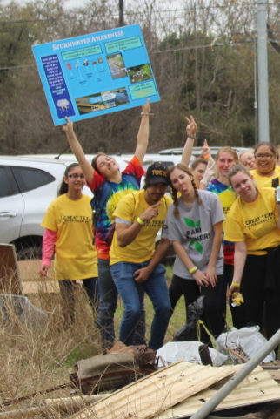
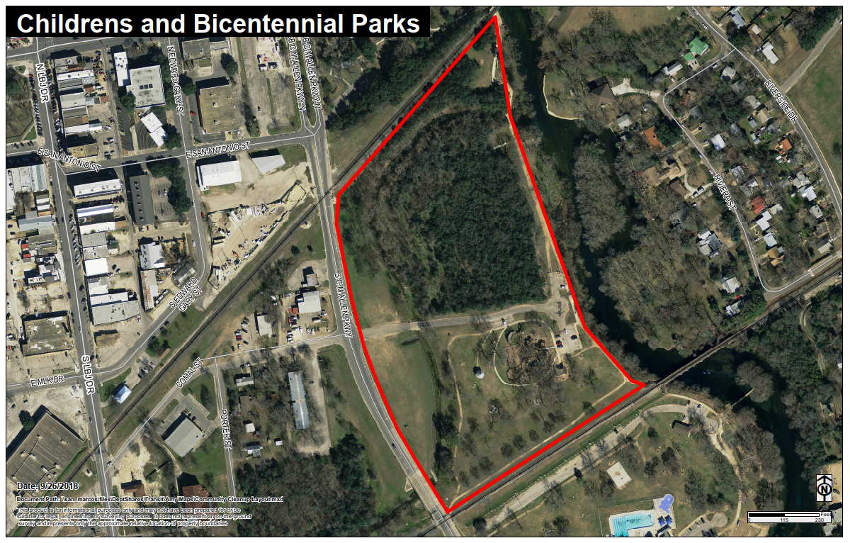
Watershed Maps

Slide 7
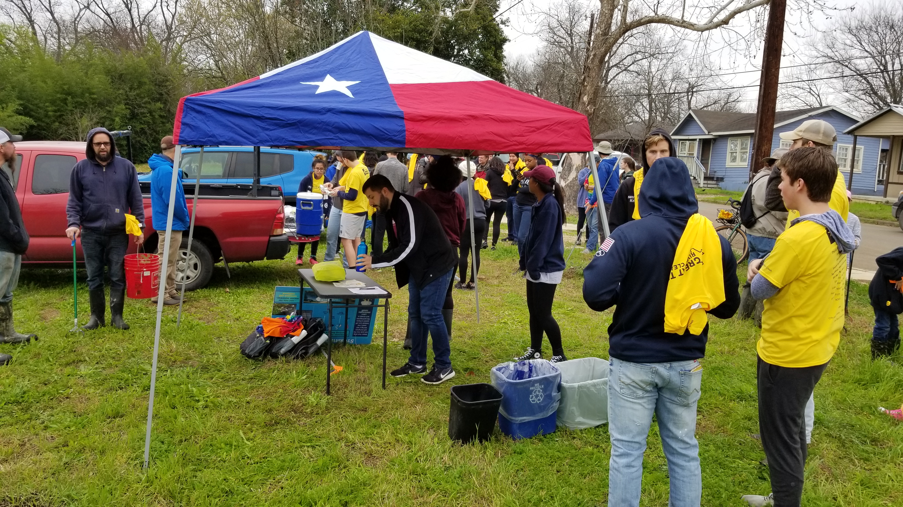
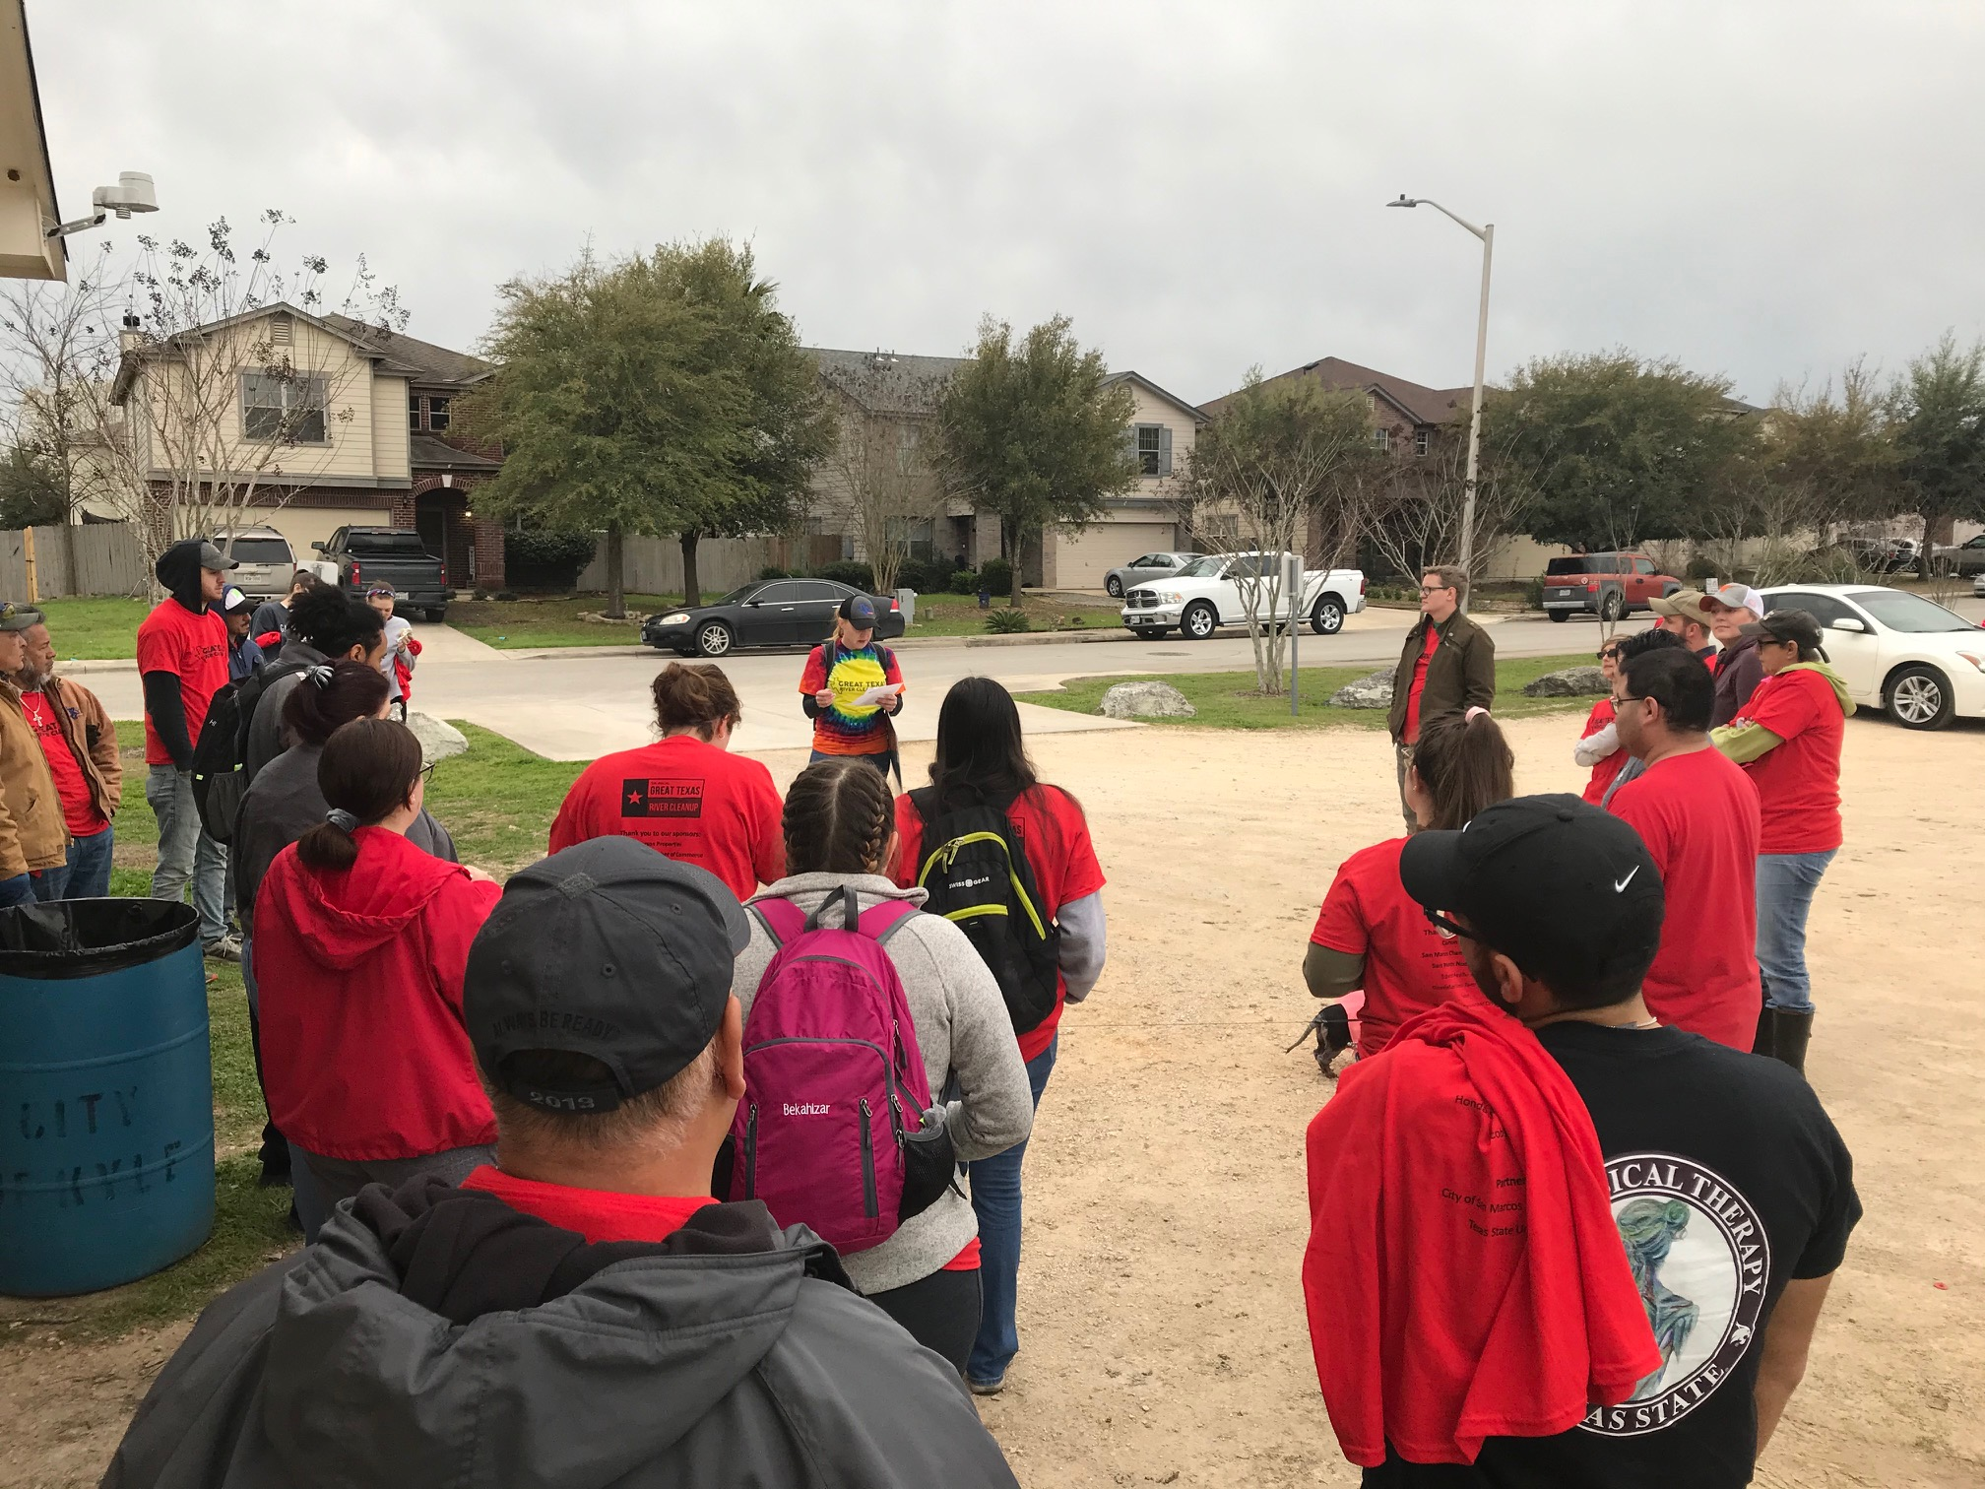
Clean Up Day- Begins!
Instructions
Sign in and getting shirt
Getting tacos and meeting friends

Slide 8
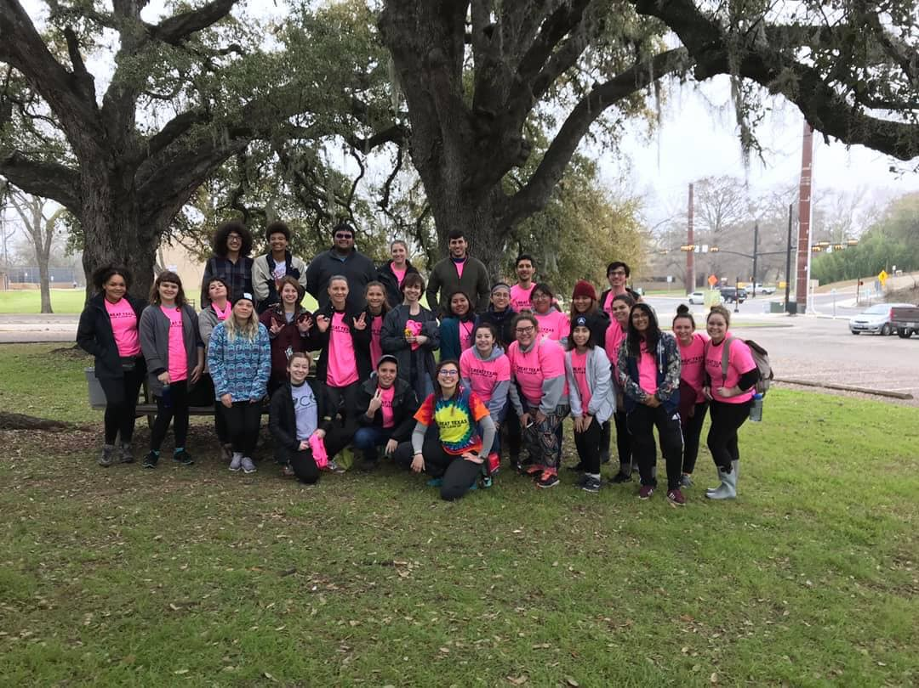
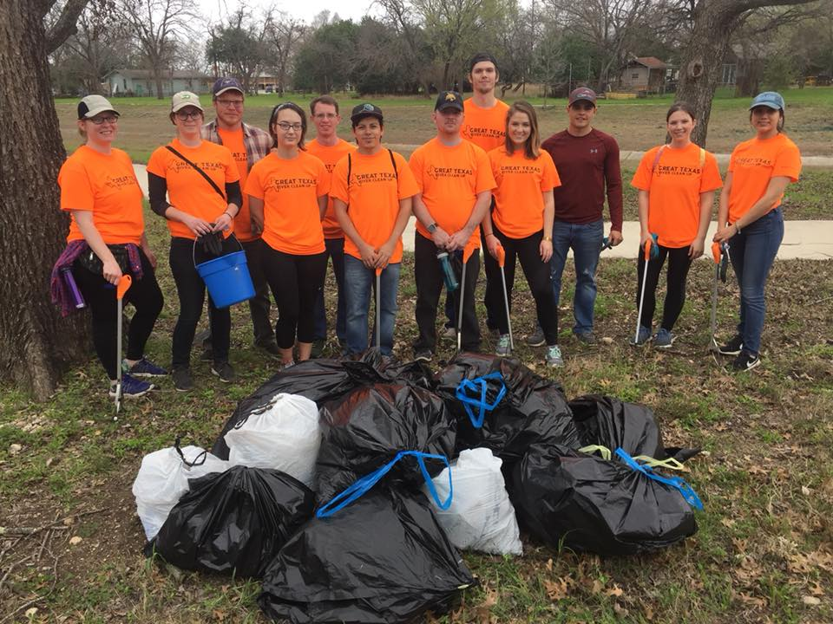
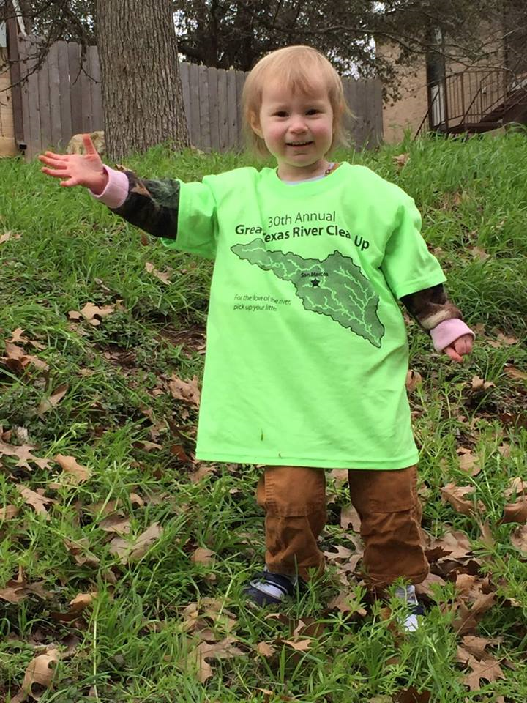
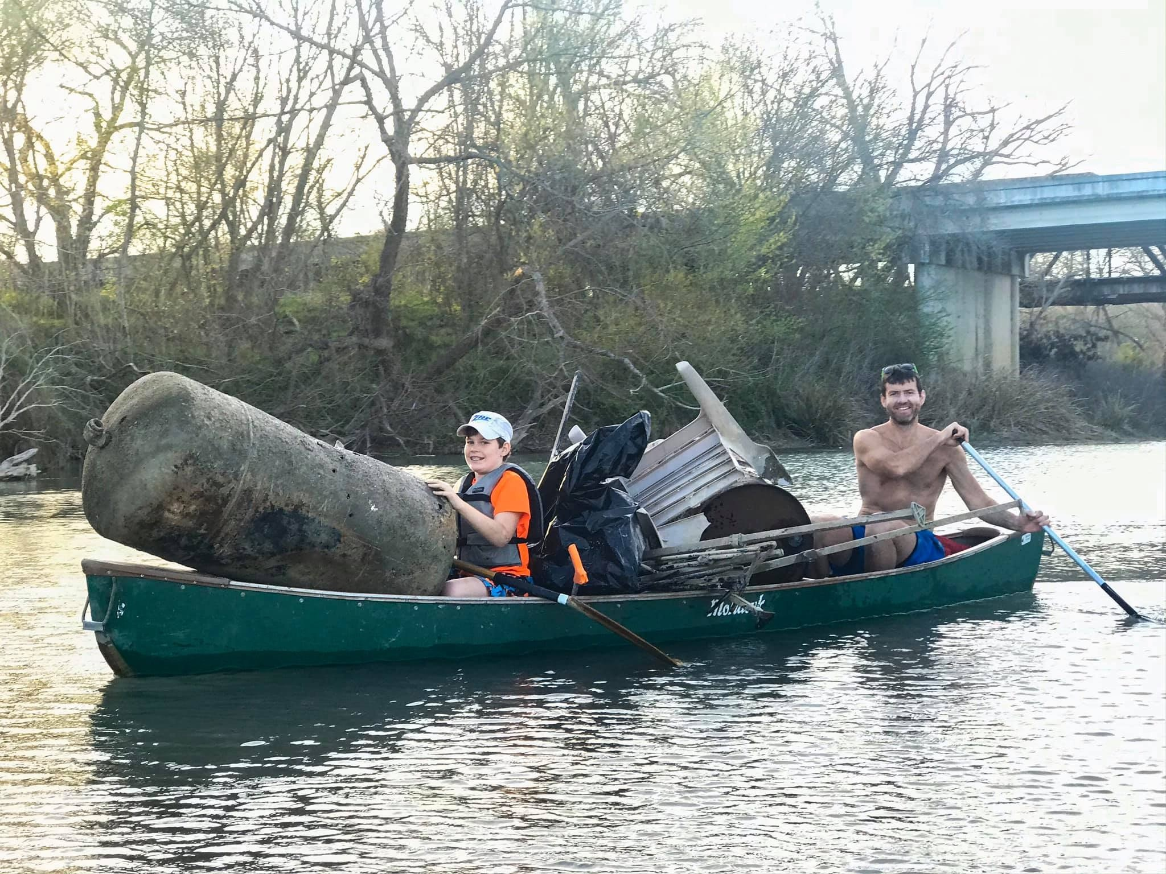
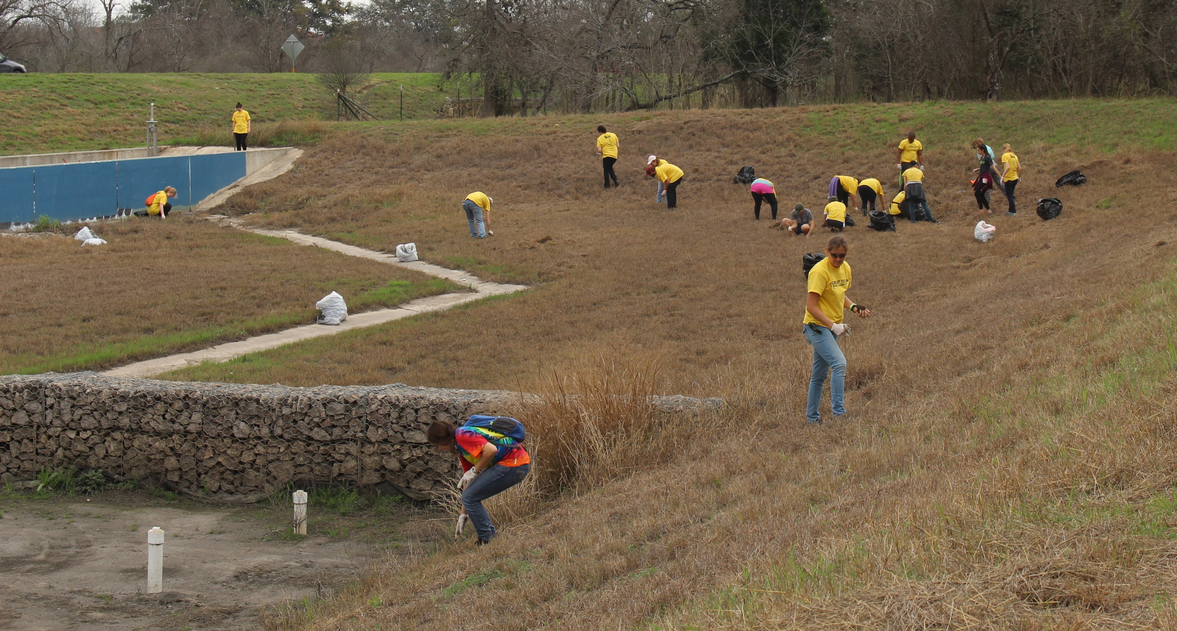
Clean Up Day- Getting it Done!

Slide 9
Totals
SPRING
FALL
 | Trash | Recycle | Tires
2017 | 11,500 | 3,430 | 37
2018 | 31,377 | 10,480 | 38
2019 | 13,100 | 4,030 | 21
2020 | 14,370 | 15,080 | 12
2021 | 5,570 | 1,970 | 50
2022 | 6,865 | 1,380 | 19
2023 | 19,605 | 1,786 | 6
 | Trash | Recycle | Tires
2017 | 2,940 | 200 | 20
2018 | 4,840 | 620 | 10
2019 | 5,400 | 1,740 | 13
2020 | 2,355 | 565 | 8
2021 | 1,980 | 530 | 3
2022 | 2,355 | 563 | 11
2023 | 10,610 | 860 | 14

Slide 10
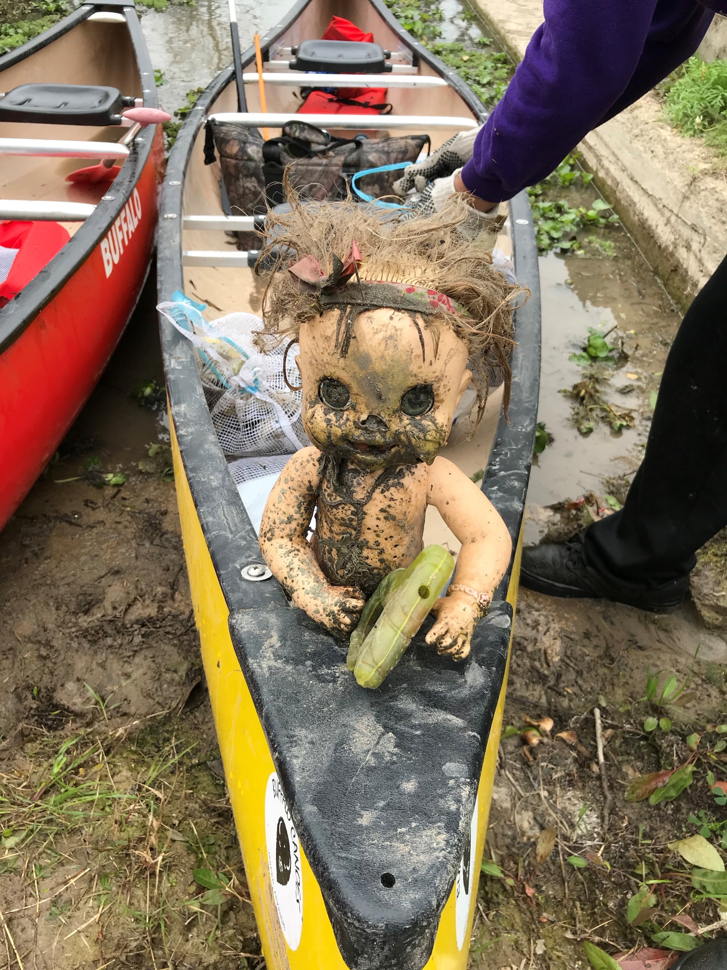
Questions
Amy Thomaides
athomaides@sanmarcostx.gov

